Slide 1

Hypothesis Testing
Sita Sapkota Roll no: 8
Section A

Slide 2
Table of Content
Introduction
In this session we will see
What a hypothesis test is
What a Z-test is
Numerical Example of Z-test

Slide 3
Hypothesis Testing
What is a hypothesis test:
A formal way to statistically test a theoretical assumption based on the data we have.
More simply hypothesis is the most important part of theory decision making.
Key concepts:
Null hypothesis H0 : Hypothesis of no difference
Alternative Hypothesis H1: Complementary Hypothesis
Significance level α : If not given we generally use 5%

Slide 4
Hypothesis Testing
Why do we need it?
Is there a significant difference between two populations?
Is there a significant relationship between two variables?
Is the mean bigger , smaller or different from a given value?

Slide 5

Z-test Example
A one sample z test is one of the most basic types of hypothesis test. In order to run a one sample z test, you work through several steps:
Step 1: State the Null Hypothesis and Alternative Hypothesis.
Step 2: Use the z-formula to find a z-score.
Step 3: Look up your z score in the z-table.

Slide 6
Numerical Example
1,500 women followed the Atkin’s diet for a month. A random sample of 31 women gained an average of 6.6 pounds. Test the hypothesis that the average weight gain per woman for the month was over 5 pounds. The standard deviation for all women in the group was 7.
Step 1:
Ho: null hypothesis: H ₀: μ = 5 or The average weight gain per woman for the month was equal to 5 pounds

Slide 7
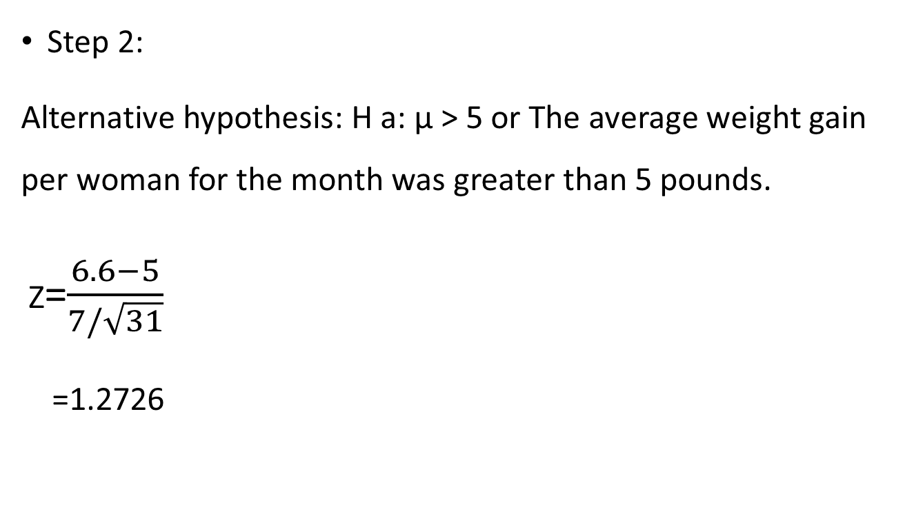
Continue…
Step 2:
Alternative hypothesis: H a: μ > 5 or The average weight gain per woman for the month was greater than 5 pounds.
Z=$\frac{6.6−5}{7/\sqrt{31}}$
=1.2726

Slide 8
Continue…
Step 3: Look up your z score in the z-table. The sample score above gives you an area of 0.8997.
We use 8% level of significance
Tabulated value for z ≤ 1.2726 is 0.8997
Z calculated is greater than Z table

Slide 9
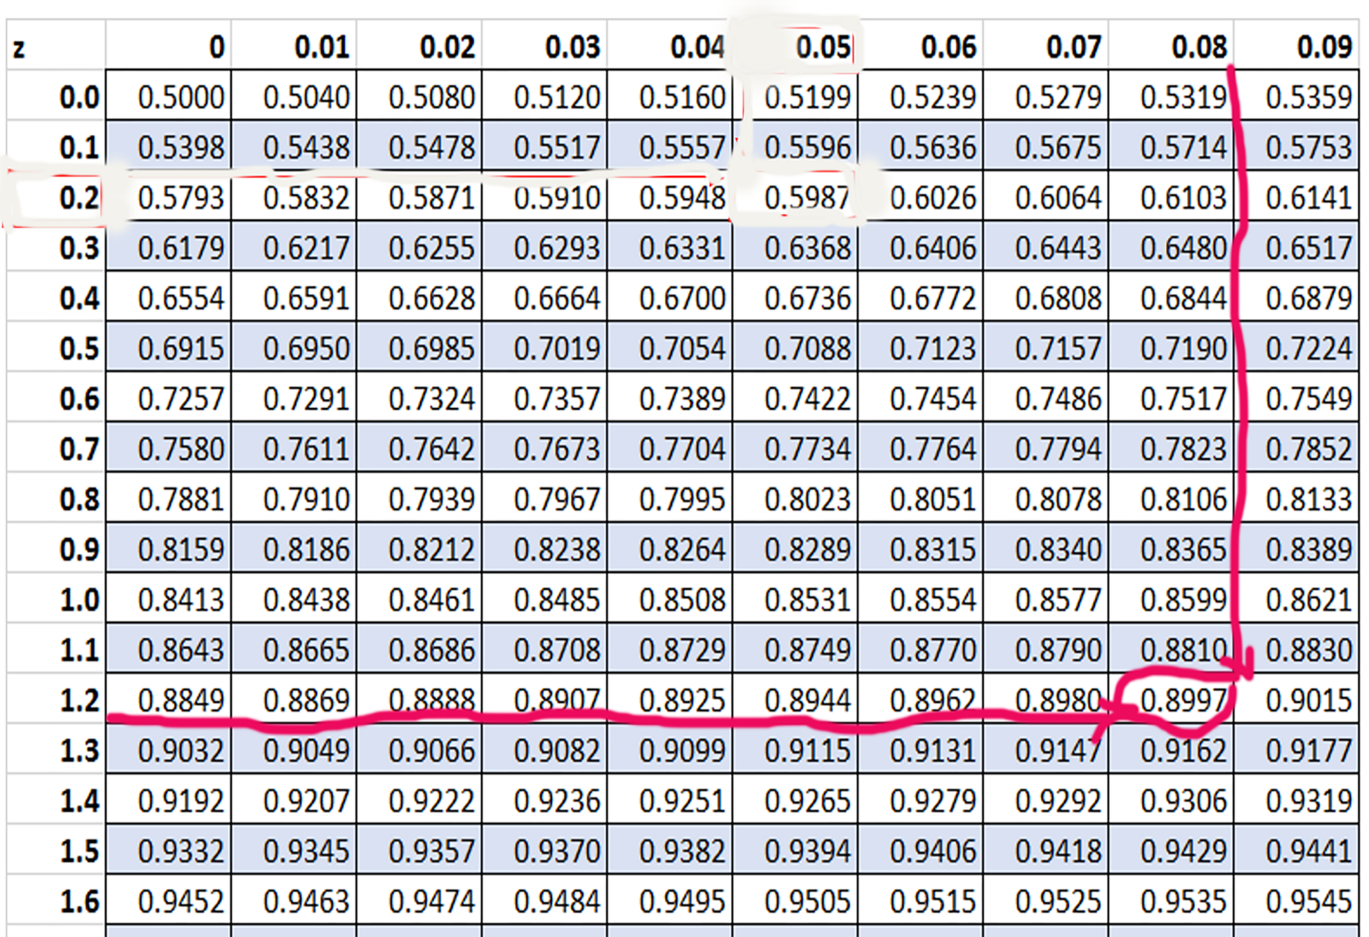

Slide 10
Conclusion
Hence it is significant. So we reject null hypothesis (H0) and accept alternative hypothesis H1 which means that the average weight gain per woman for the month was over 5 pounds.

Slide 11
Questions?
Thank You!

